Slide 1
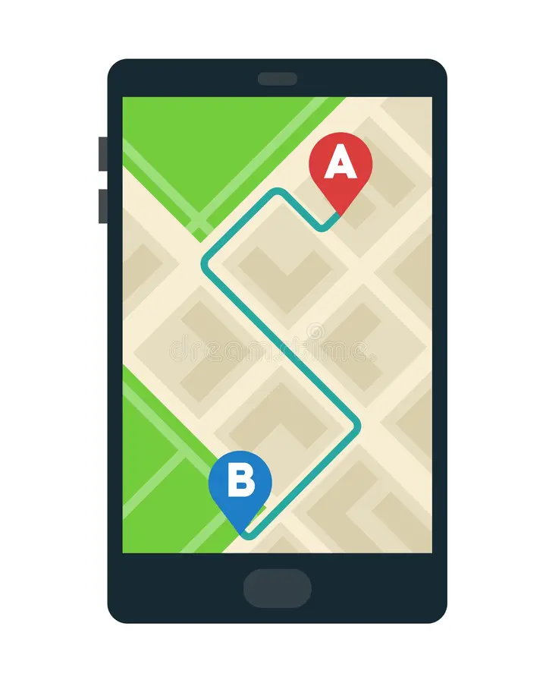
1

Slide 2

2
Thinking to relative home

Slide 3
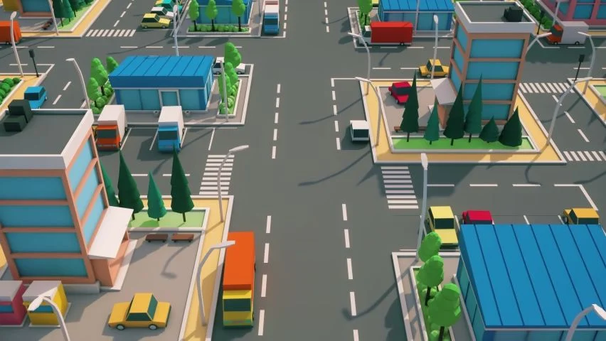
Relative home street
2

Slide 4

2

Slide 5
3
To
From

Slide 6
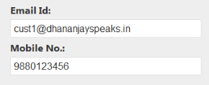

To

Slide 7

OTP ENTER

Slide 8
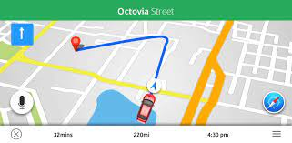

To reach the home

Slide 9
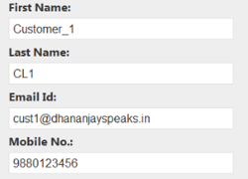


From

Slide 10

Home locate

